Slide 1


Online fruits shop
Name: Meenakshi. K
Destination: Developer
Department: ETPL

Slide 2

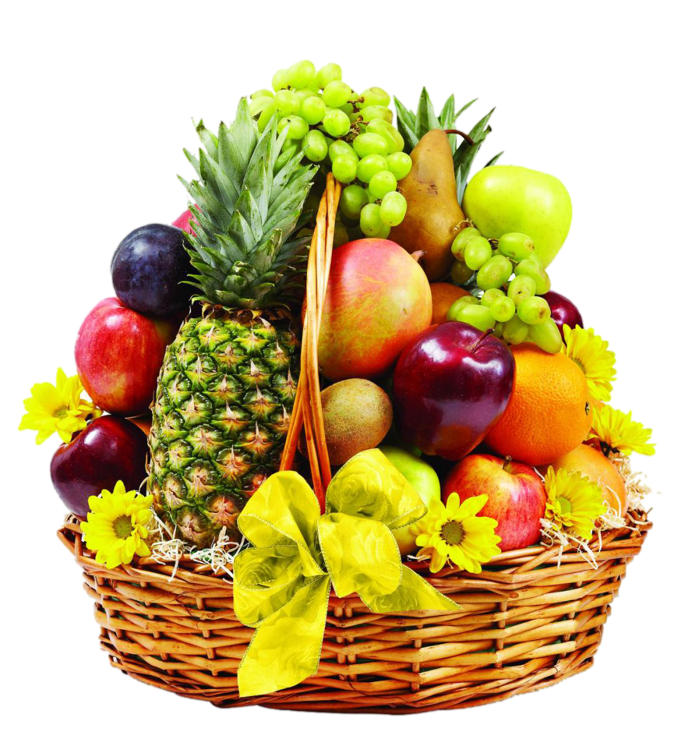
AGENDA
01 | Introduction
02 | system software
03 | Target
04 | Flow Diagram
05 | Plugin
06 | Benefit & Limitation
07 | Screenshot
08 | Question

Slide 3
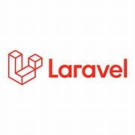
INTRODUCTION
Laravel is an open-source PHP web framework
Designed for building modern web applications.
Developed by Taylor Otwell and released in 2011
Laravel has rapidly gained popularity in the PHP community
Provides with commonly used functions or APIs

Slide 4
INTRODUCTION
Composer Integration: Laravel utilizes Composer, the PHP package manager, to manage its dependencies and make it easy to install and update packages.
Routing: making it easy to handle HTTP requests and define custom URL structures.
Blade Templating Engine: This allows developers to write clean and efficient PHP code for their views
Authentication and Authorization: Laravel makes implementing authentication and authorization systems a breeze with its built-in features and easy-to-use APIs.
Artisan-Laravel includes a command-line tool called Artisan

Slide 5
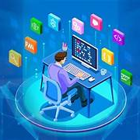
system Software
Operating System: Windows 11
Frontend Technologies: HTML, CSS, JavaScript
Backend Framework: Laravel (PHP)
Database Language: SQL
Development Environment: VS Code, XAMPP, Composer
Server: localhost:8000

Slide 6
Target
At MM Online Fruits Shop, we believe in providing our customers with the freshest and most flavorful fruits available.
We source our fruits directly from trusted growers and suppliers, ensuring that each piece meets our stringent standards for freshness and taste.
With just a few clicks, you can browse through our extensive collection, place your order, and have it delivered straight to your home or office.
Whether you're looking for healthy fruits, ingredients for your favorite recipes, or a thoughtful gift for a loved one, MM Fruits Shop has you covered.
Experience the ease and pleasure of shopping for fruits online with us today!.

Slide 7

Flow diagram
START
USER
ADMIN
View product
Buy a product
View product
Create product
Update product
Delete product

Slide 8
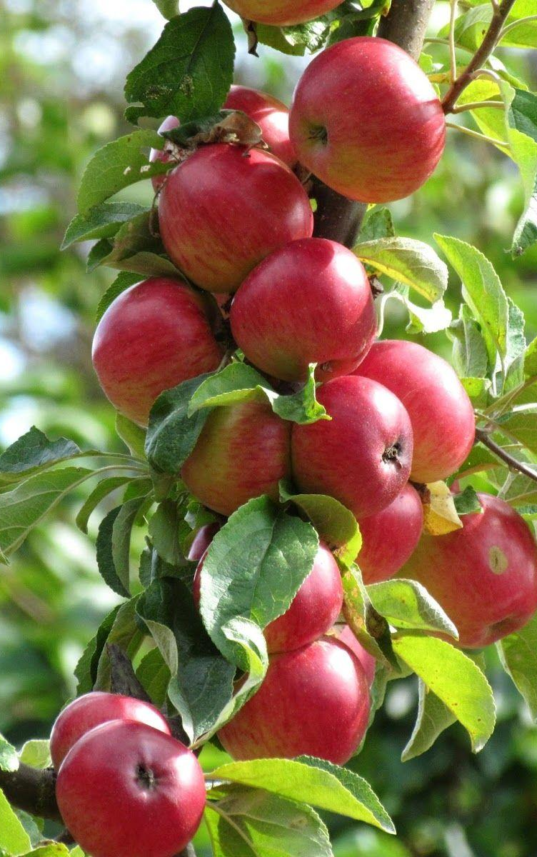
Plugin
1. User
View Homepage
Add to Cart
2. Admin
Create Product
View Product
Update Product
Delete Product

Slide 9



Benefit
making it a popular choice for developers worldwide.
Database Migration System: This makes it easier to manage database changes
Powerful Routing System: To define application routes and handle HTTP requests effectively.
Blade Templating Engine: make it easy to build complex user interfaces

Slide 10

Limitation
Dependency on Composer Packages
Upgrading Challenges
Security Concerns-CSRF protection
Community Support- like Ruby on Rails or Django

Slide 11
Screen shot

Slide 12
Screen shot

Slide 13
Screen shot

Slide 14
Screen shot

Slide 15
Screen shot

Slide 16

Question?

Slide 17


